Slide 1
Methodology of CS
Introduction to algorithms
Dustin Xu

Slide 2
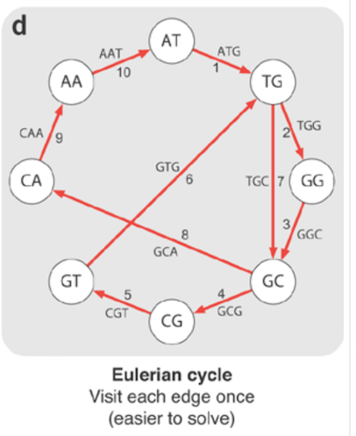
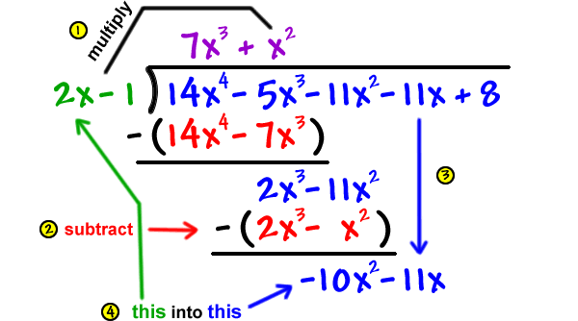
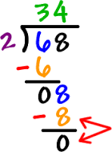
What is an algorithm?
How to use addition(+), subtraction(-), multiplication(*), and division(/)?
How to draw one line and visit all edges in a graph?
Notes:
Long Division
Eulerian Path

Slide 3
What is an algorithm?
a set of rules that precisely defines a sequence of operations
addition(+), subtraction(-), multiplication(*), and division(/)
Euclid’s Algorithm to obtain greatest common divisor (gcd)
Sort Algorithms
Eulerian Path Algorithm
Shortest Path Algorithms
(Dijkstra, SPFA, Floyd)
How to design a delivery route for a courier in S.F. Express?
How to analyze big data?
How to play chess with AlphaGo?

Slide 4
How to evaluate an algorithm?
Computational Complexity

Slide 5
Computational Complexity
Rough Estimation
Time Complexity
Space Complexity
Time needed for a sequence of operations
Time Efficiency
Running time is always measured to evaluate an algorithm.
It also depends on CPU and other factors.
Space needed for data structures used in a program
Space Efficiency
Memory is always measured to evaluate an algorithm.
It also depends on programming language and other factors.
Specific Evaluation

Slide 6
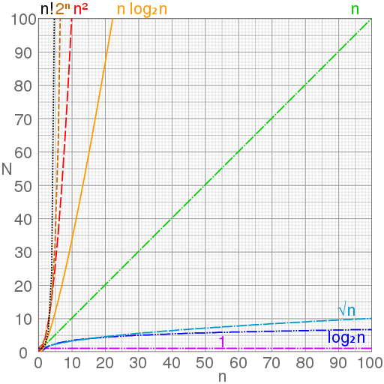
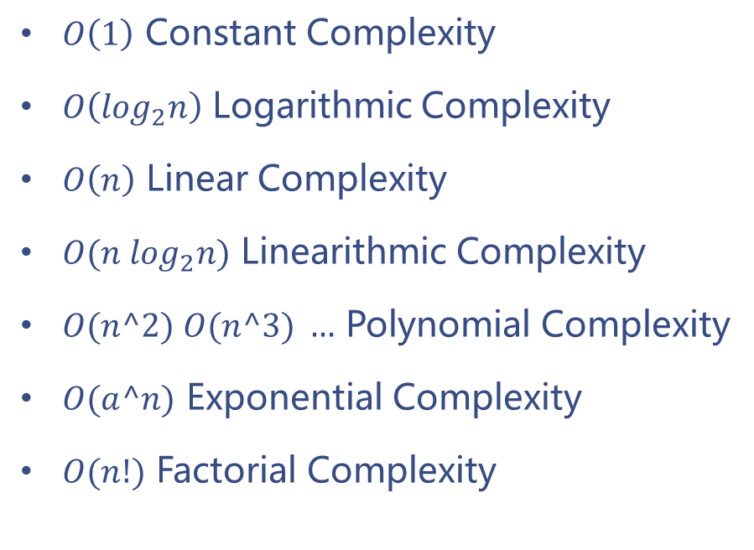
Computational Complexity
Big O Notation
$O\left(1\right)$ Constant Complexity
$O\left(\log_{2}n\right)$ Logarithmic Complexity
$O\left(n\right)$ Linear Complexity
$O(n \log_{2}n)$ Linearithmic Complexity
$O(n^2) O(n^3) …$ Polynomial Complexity
$O(a^n)$ Exponential Complexity
$O(n!)$ Factorial Complexity

Slide 7
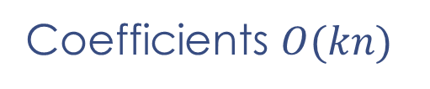
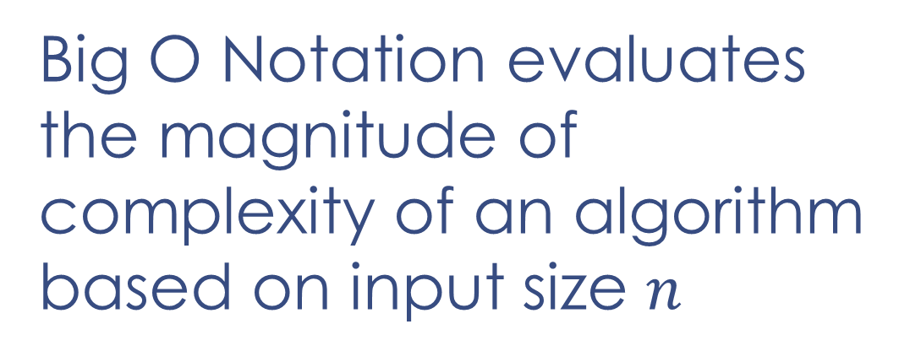

Core Ideas
Big O Notation evaluates the magnitude of complexity of an algorithm based on input size $n$
Coefficients $O(kn)$
✗
Constant $O(n+C)$
✗

Slide 8
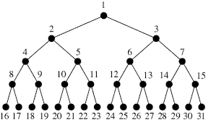

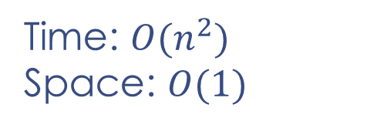
Some Examples
Look for a number in this perfect binary tree with $n$ nodes from the root.
count = 0
for i in range(n):
for j in range(i,n):
count += 1
Time: $O(n^{2})$
Space: $O(1)$

Slide 9
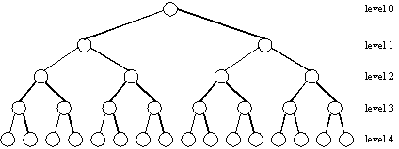
A Perfect Binary Tree
Decimal | Binary
5 | 101
14 | 1110
15 | 1111
16 | 10000
1
0
1
2
3
0
1
0
1
4
5
6
7
0
1
0
1
0
1
0
1
8
9
10
11
12
13
14
15
0
1
16
31
The depth of a perfect binary tree with $n$ nodes is $int(\log_{2}{n})$

Slide 10
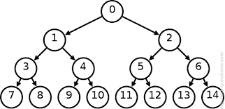
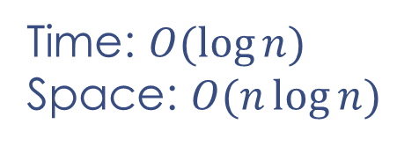
Some Examples
Look for a number in this perfect binary tree with $n$ nodes from the root.
count = 0
for i in range(n):
for j in range(i,n):
count += 1
Time: $O(n^{2})$
Space: $O(1)$
Time: $O(\log{n})$
Space: $O(n\log{n})$

Slide 11
Fibonacci Numbers
A Task For You

Slide 12
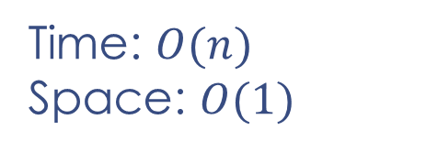
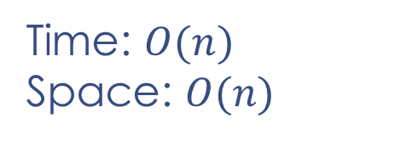
Algorithm A
f = [1,1]
for i in range(2,n):
f.append(f[i-1]+f[i-2])
print(f[n-1])
Time: $O(n)$
Space: $O(n)$
f = [1,1]
for i in range(2,n):
f[i%2] += f[(i+1)%2]
print(f[(n-1)%2])
Time: $O(n)$
Space: $O(1)$

Slide 13

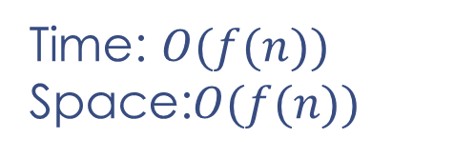



Algorithm B
An exponential time algorithm
Time: $O(f(n))$
Space:$O(f(n))$
def f(n):
if n <= 2:
return 1
return f(n-1) + f(n-2)
print(f(n))
Push
Pop
$$f(n−3)$$
Stack Overflow!
$$f(n−2)$$
$$f(n−1)$$
$$f(n)$$

Slide 14
Algorithm B
An exponential time algorithm
Time: $O(f(n))$
Space:$O(f(n))$
def f(n):
if n <= 2:
return 1
return f(n-1) + f(n-2)
print(f(n))
Push
Pop
$$f(n−3)$$
Stack Overflow!
$$f(n−2)$$
$$f(n−1)$$
$$f(n)$$

Slide 15
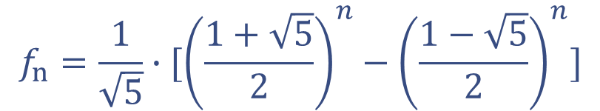
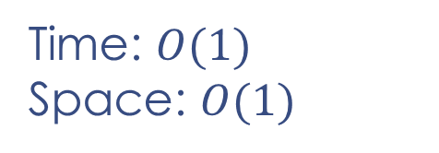
Algorithm C
sqrt5 = 5**0.5
print(1/sqrt5*(((1+sqrt5)/2)**n-((1-sqrt5)/2)**n))
Time: $O(1)$
Space: $O(1)$
$$f_{n}=\frac{1}{\sqrt{5}}∙[{\left(\frac{1+\sqrt{5}}{2}\right)}^{n}−{\left(\frac{1−\sqrt{5}}{2}\right)}^{n}]$$

Slide 16
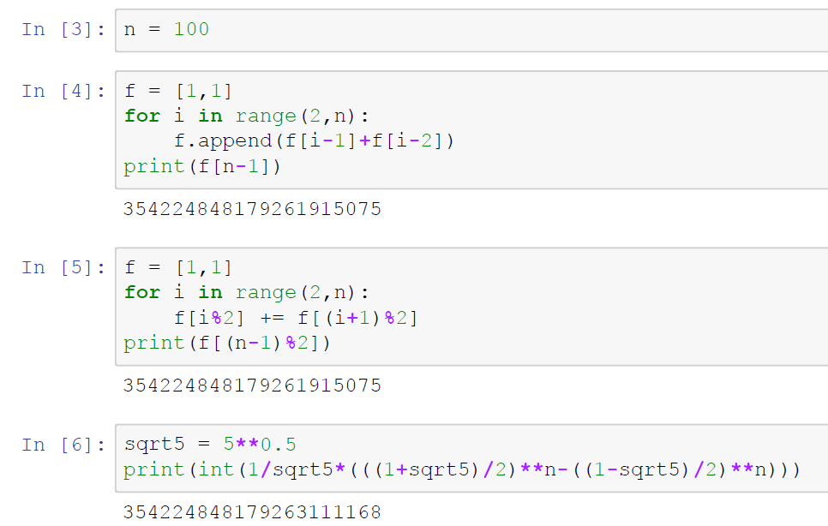

Slide 17
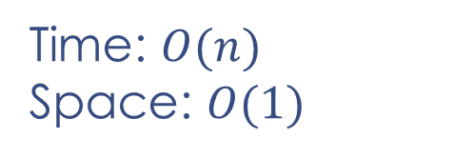
The Best Algorithm
?
f = [1,1]
for i in range(2,n):
f[i%2] += f[(i+1)%2]
print(f[(n-1)%2])
Time: $O(n)$
Space: $O(1)$

Slide 18
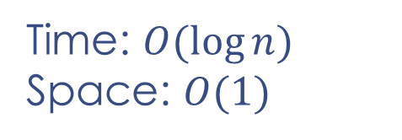
A Better Algorithm
Fast Matrix Exponentiation
Matrix Multiplication & Divide and Conquer
Time: $O(\log{n})$
Space: $O(1)$

Slide 19
Thank you!

